Slide 1


SITA3008 and Internet of Things
E.Srividhya
DEPARTMENT OF COMPUTER SCIENCE AND ENGINEERING

Slide 2
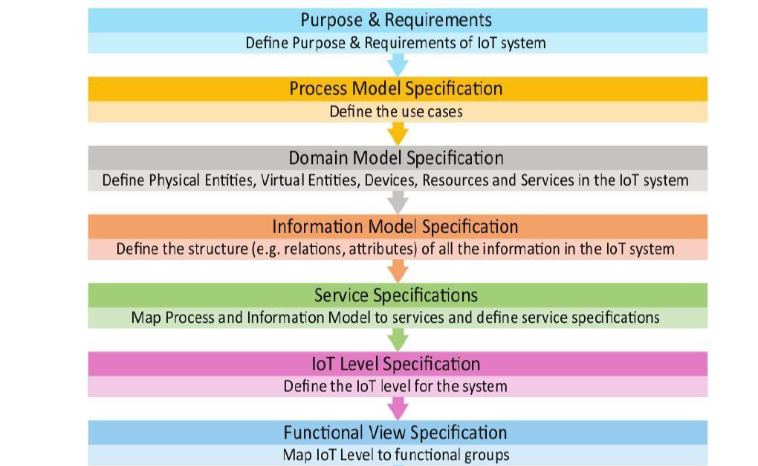
Design and Development of IOT

Slide 3
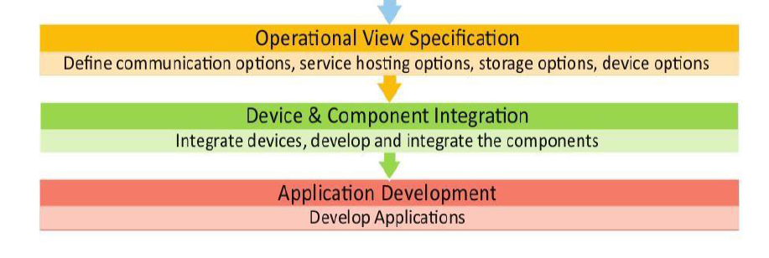

Slide 4
Step 1: Purpose & Requirements Specification
Step 2: Process Specification
Step 3: Domain Model Specification
Step 4: Information Model Specification
Step 5: Service Specifications
Step 6: IoT Level Specification
Step 7: Functional View Specification
Step 8: Operational View Specification
Step 9: Device & Component Integration
Step 10: Application Development

Slide 5
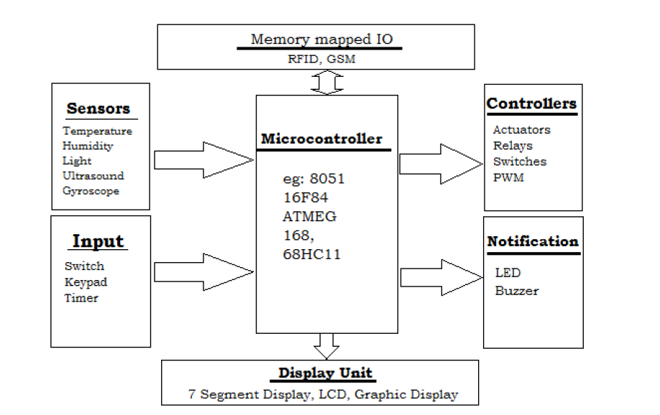
Embedded system hardware

Slide 6
Embedded system - Software
The embedded system that uses the devices for the operating system is based on the language platform, mainly where the real-time operation would be performed.

Slide 7
Microcontrollers for Embedded Computing with IoT Devices
Bit depth
Memory
GPIO
Power Consumption

Slide 8
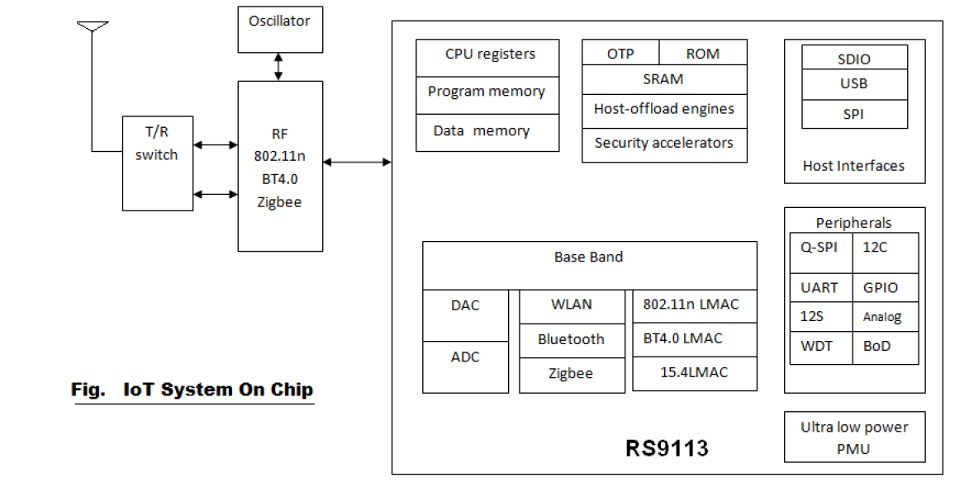
IOT System on chip

Slide 9
IoT SoC (system on chip in IoT) can be used for numerous applications as :
Mobile
• M2M-Communication
• Real time location finding tags
• Thermostats
• Smart meters
• Wireless sensor devices
• Serial to WiFi converter
• Voice Over WiFi compliant phones
• Home automation
• Health care devices and equipments

Slide 10
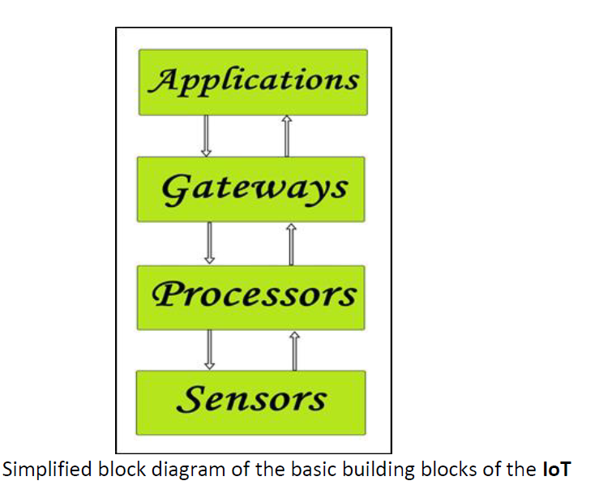
Building Blocks Of IoT

Slide 11
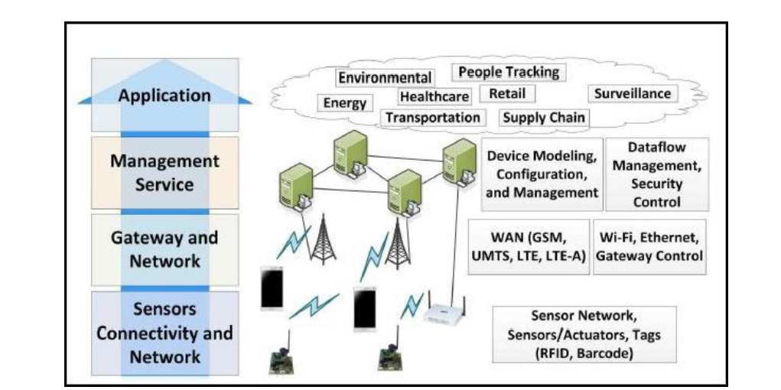
IoT Architecture Layers

Slide 12
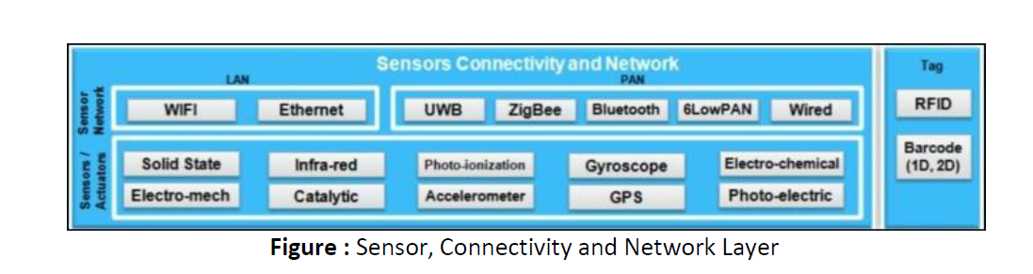

Slide 13
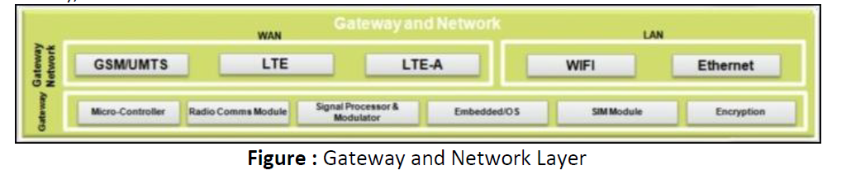

Slide 14
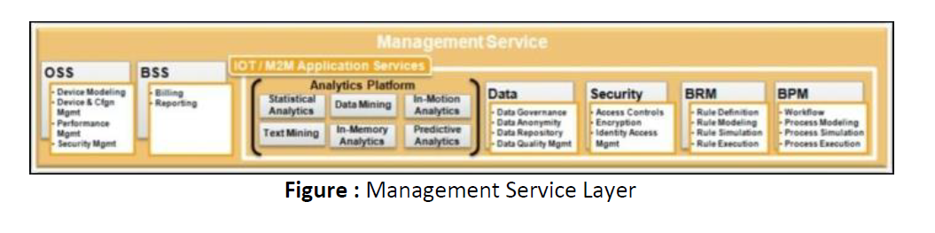

Slide 15
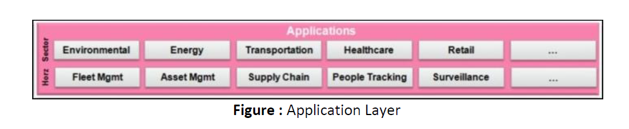

Slide 16
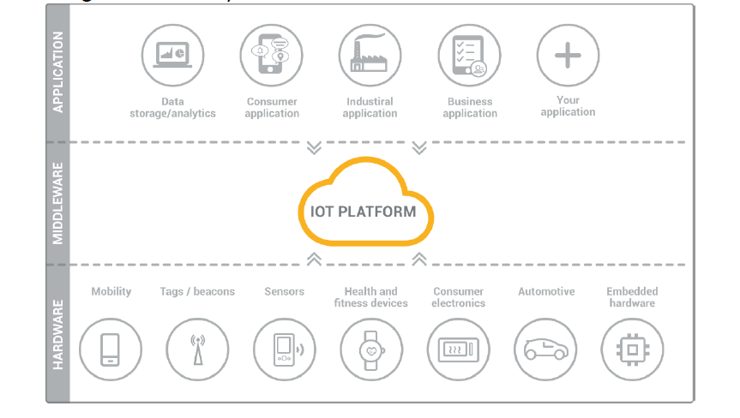
IoT platform as the middleware

Slide 17
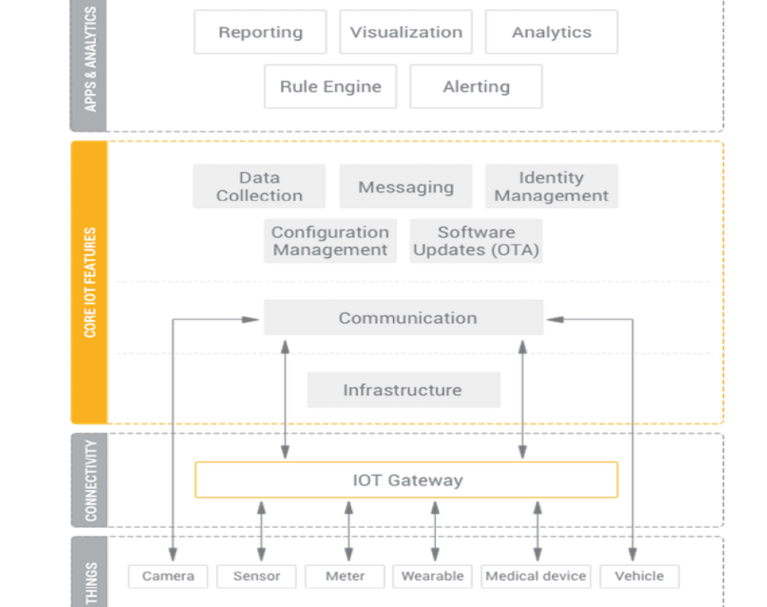

Slide 18
Overview of IoT supported Hardware platforms
Cutting across these aspects, there are two different paradigms of IoT solution cluster deployment offered by IoT platform providers:
public cloud IoT PaaS
self-hosted private IoT cloud.

Slide 19
IoT cloud enablement
Platform-as-aservice (PaaS) allows you to rent cloud infrastructure and an IoT platform all from a single technology provider.
There might be ready-to-use IoT solutions (IoT cloud services) offered by the provider, built and hosted on its infrastructure.
However, one important capability of a modern IoT platform consists in a private IoT cloud enablement.
As opposed to public PaaS solutions located at a provider’s cloud, a private IoT cloud can be hosted on any cloud infrastructure, including a private data center.

Slide 20
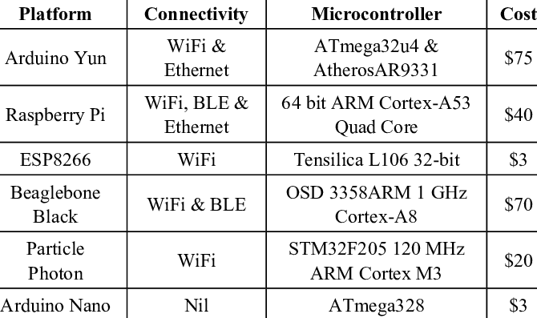

Slide 21
Arduino
Arduino is a prototype platform (open-source) based on an easy-to-use hardware and software.
It consists of a circuit board, which can be programed (referred to as a microcontroller) and a ready-made software called Arduino IDE (Integrated Development Environment), which is used to write and upload the computer code to the physical board.

Slide 22
key features ardunio
Arduino boards are able to read analog or digital input signals from different sensors
Control your board functions by sending a set of instructions to the microcontroller
Arduino does not need an extra piece of hardware (called a programmer) in order to load a new code onto the board.
Arduino IDE uses a simplified version of C++.
Arduino provides a standard form factor.

Slide 23
Board Types
Various kinds of Arduino boards are available depending on different microcontrollers used.
However, all Arduino boards have one thing in common: they are programed through the Arduino IDE.
The differences are based on the number of inputs and outputs (the number of sensors, LEDs, and buttons you can use on a single board), speed, operating voltage, form factor etc.
Some boards are designed to be embedded and have no programming interface which you would need to buy separately.
Some can run directly from a 3.7V battery, others need at least 5V

Slide 24
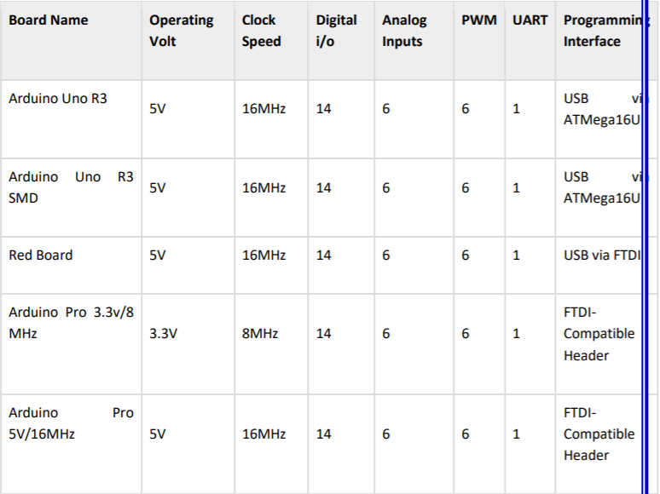

Slide 25
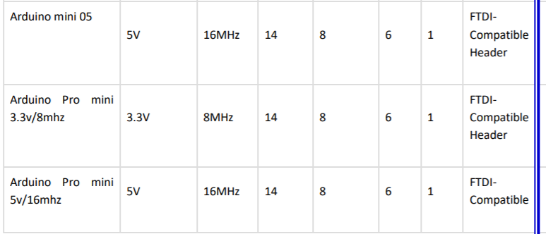

Slide 26
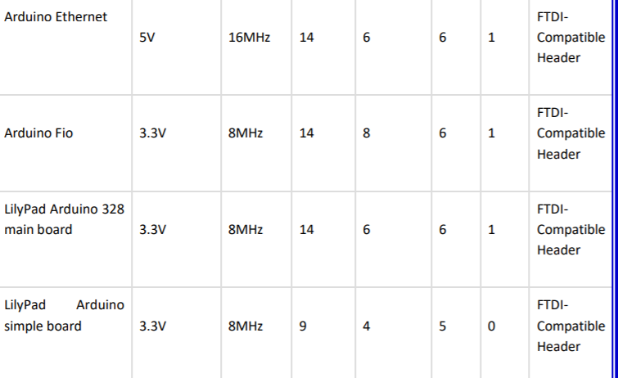

Slide 27
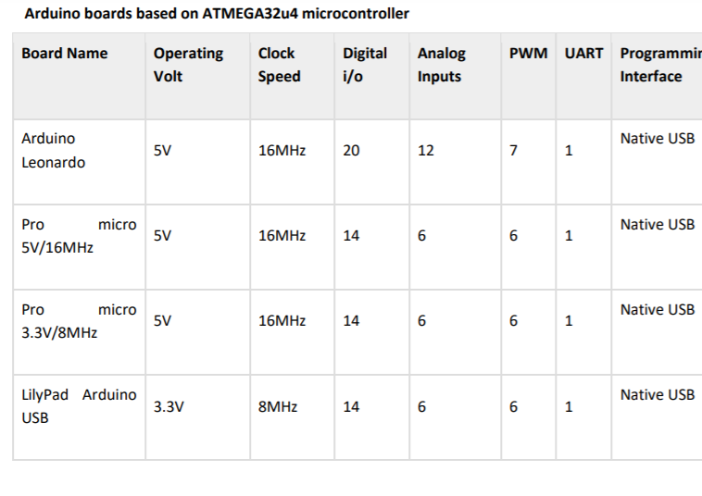

Slide 28
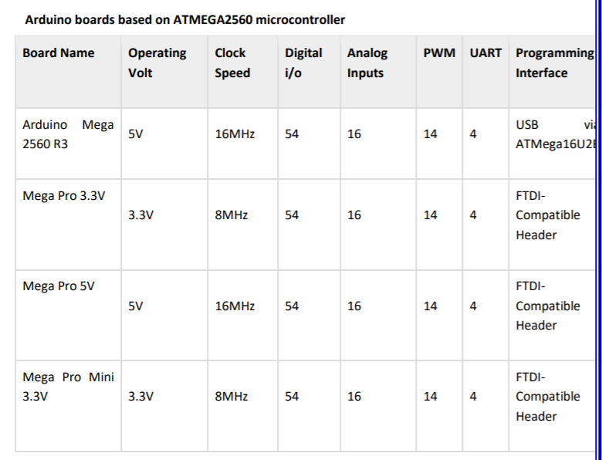

Slide 29
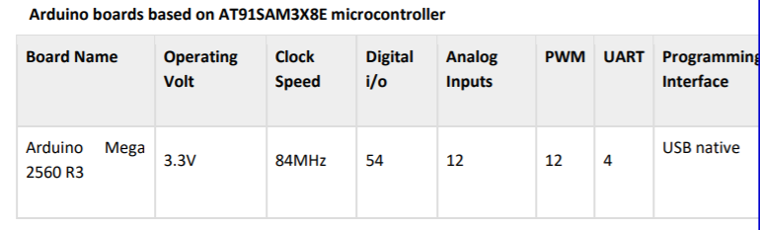

Slide 30
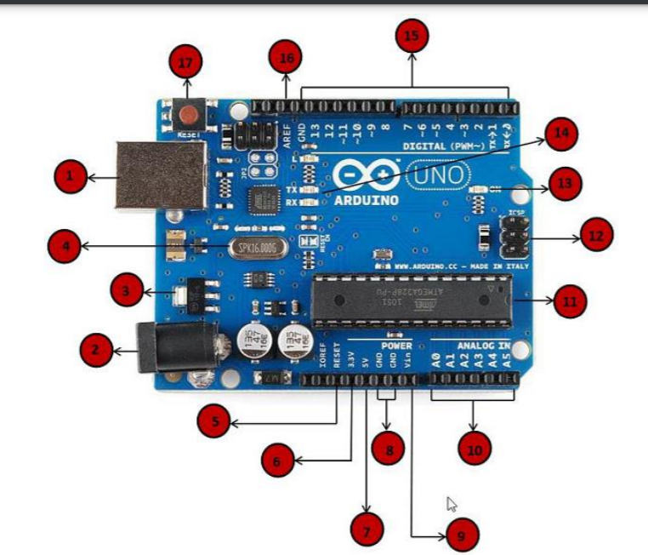

Slide 31
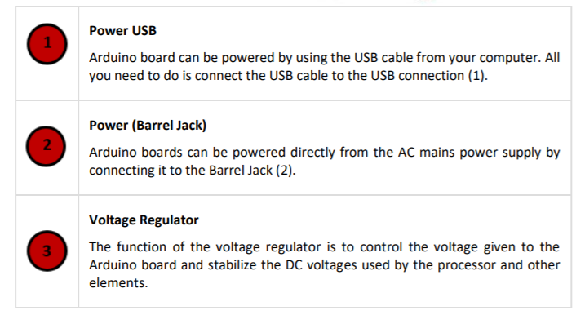

Slide 32
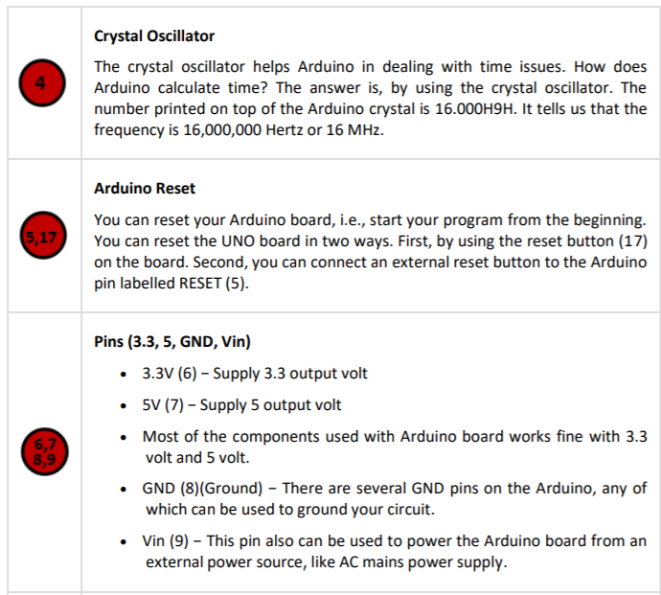

Slide 33
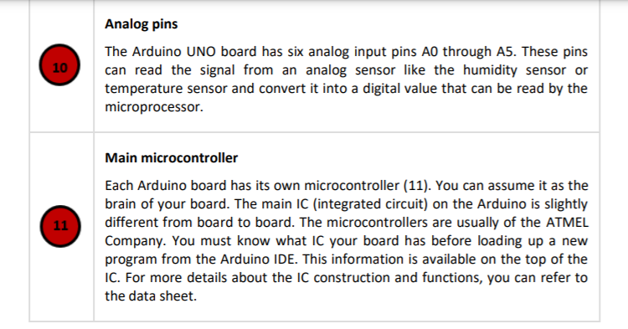

Slide 34
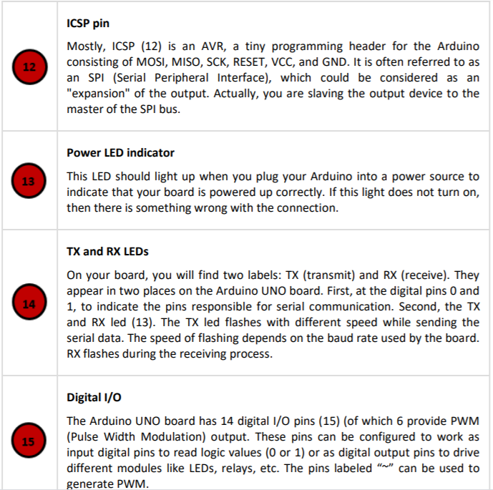

Slide 35
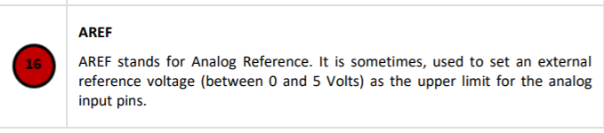

Slide 36
Arduino IDE
Step 1 − First you must have your Arduino board (you can choose your favorite board) and a USB cable.
Step 2 − Download Arduino IDE Software

Slide 37
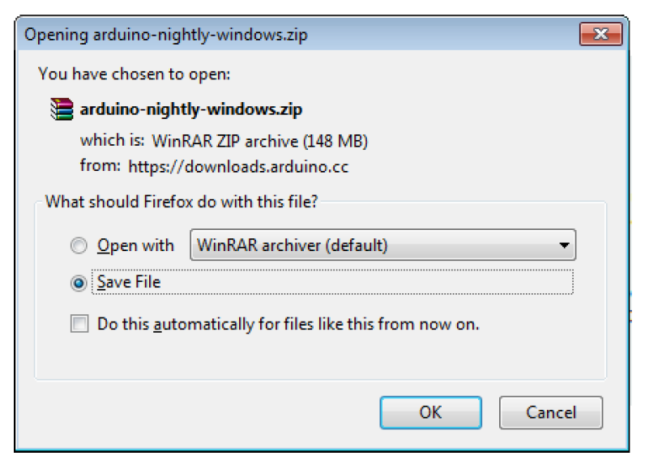

Slide 38
Step 3 − Power up your board
Step 4 − Launch Arduino IDE

Slide 39
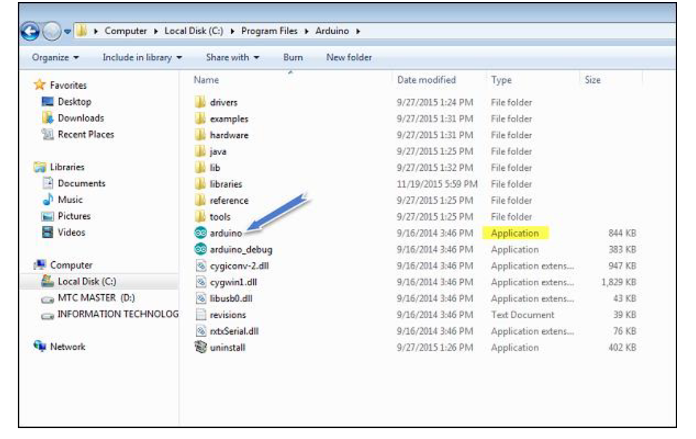

Slide 40
Step 5 − Open your first project.
Once the software starts, you have two options −
-Create a new project.
-Open an existing project example.
To create a new project, select File → New.

Slide 41
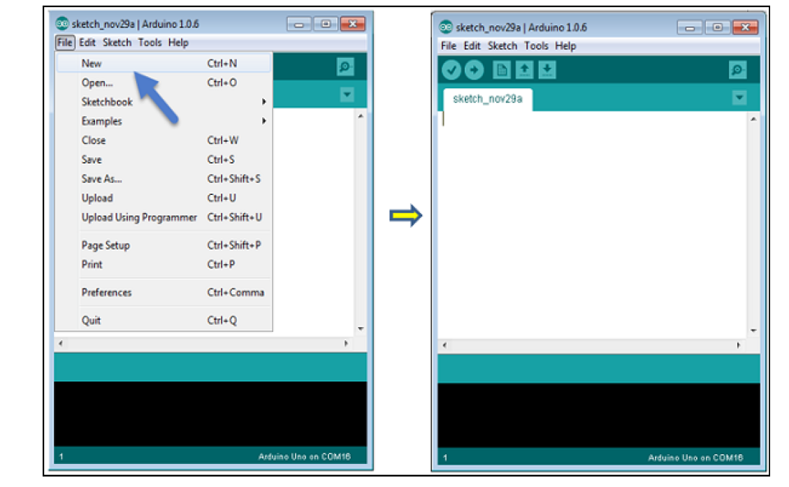

Slide 42
To open an existing project example, select File → Example → Basics → Blink.

Slide 43
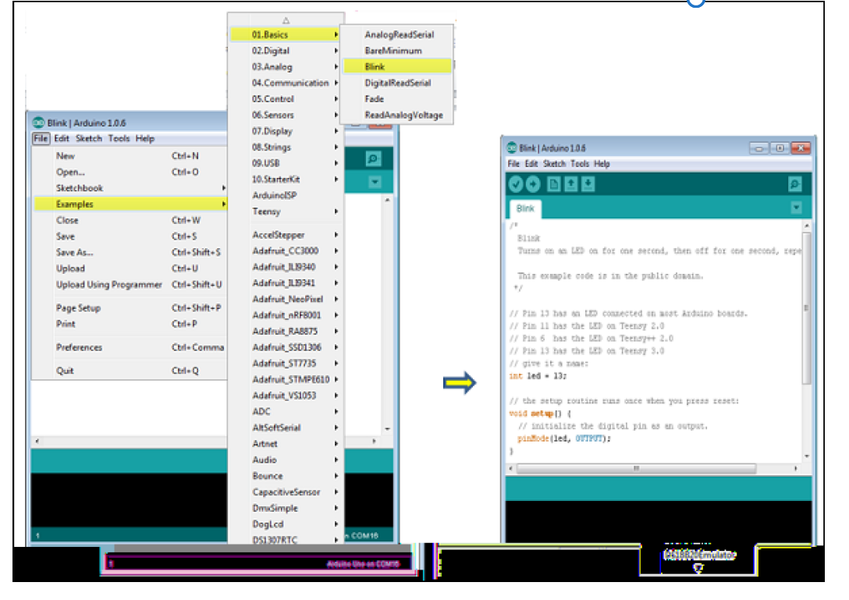

Slide 44
Here, we are selecting just one of the examples with the name Blink. It turns the LED on and off with some time delay. You can select any other example from the list.
Step 6 − Select your Arduino board.
To avoid any error while uploading your program to the board, you must select the correct Arduino board name, which matches with the board connected to your computer.
Go to Tools → Board and select your board.

Slide 45
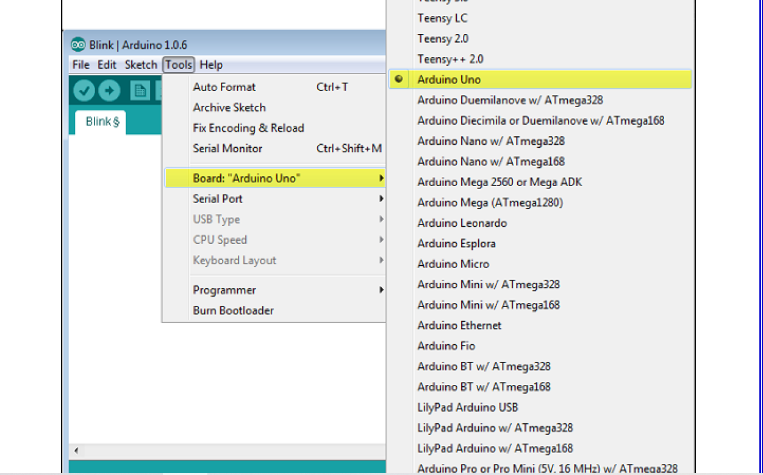

Slide 46
Here, we have selected Arduino Uno board according to our tutorial, but you must select the name matching the board that you are using.
Step 7 − Select your serial port

Slide 47
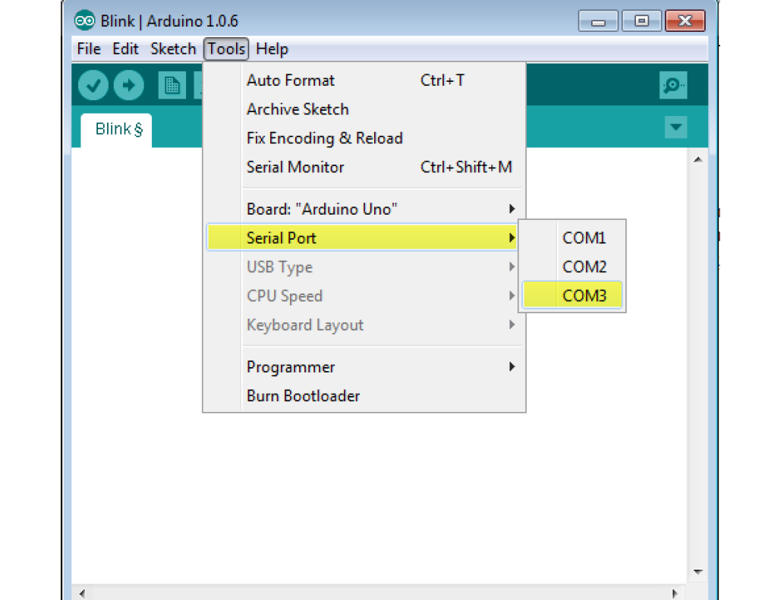

Slide 48
Step 8 − Upload the program to your board.

Slide 49
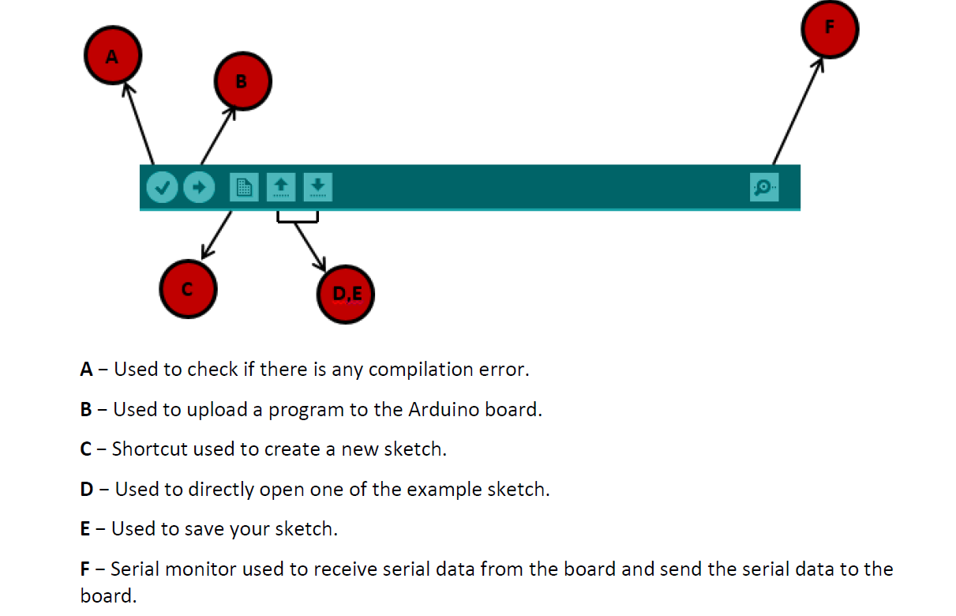

Slide 50
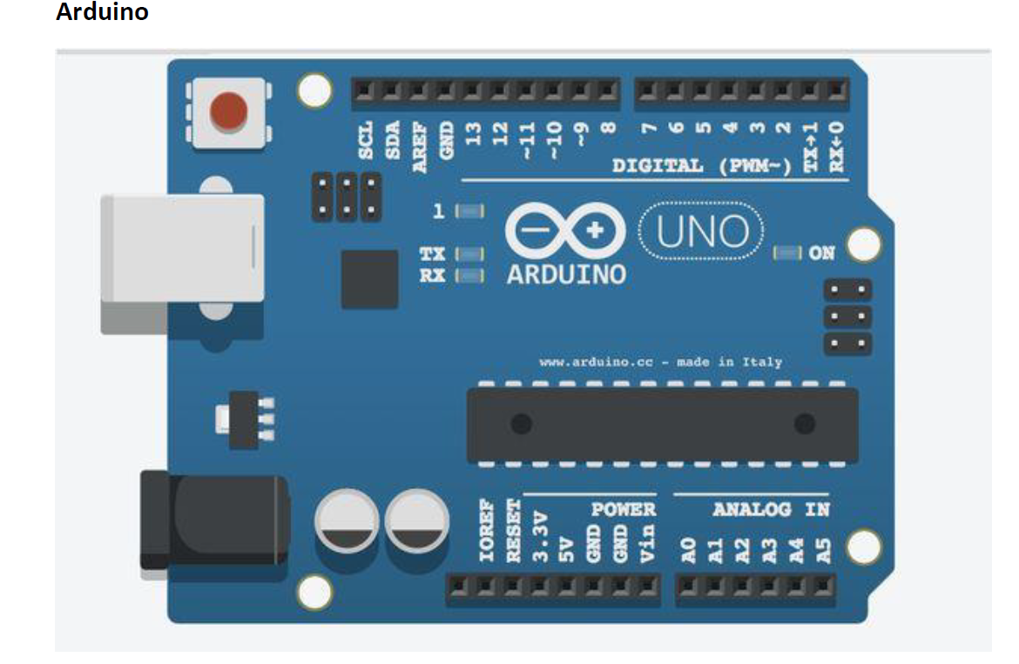
IoT Platforms Overview: Arduino, Raspberry Pi

Slide 51
The Arduino platform was created back in 2005 by the Arduino company.
Arduino is sensible to literally every environment by receiving source data from different external sensors and is capable to interact with other control elements over various devices, engines and drives.
Arduino has a built-in micro controller that operates on the Arduino software.

Slide 52
The integrated development environment (IDE) is composed of the open source code and works equally good with Мac, Linux and Windows OS.
Based on a processing programming language, the Arduino platform seems to be created for new users and for experiments

Slide 53
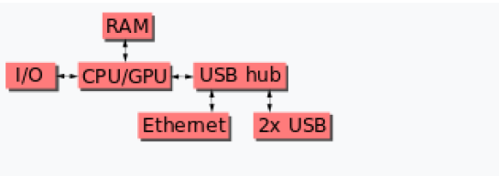
Raspberry Pi
Raspberry Pi (/paɪ/) is a series of small single-board computers developed in the United Kingdom by the Raspberry Pi Foundation in association with Broadcom
After the release of the second board type, the Raspberry Pi Foundation set up a new entity, named Raspberry Pi Trading, and installed Eben Upton as CEO, with the responsibility of developing technology

Slide 54
